Slide 1


StyleBlit: Fast Example-Based Stylization with Local Guidance
Daniel Sýkora¹, Ondřej Jamriška¹, Ondřej Texler^{1,2},
Jakub Fišer², Michal Lukáč², Jingwan Lu², Eli Shechtman²,
1
2
CTU in Prague, FEE

Slide 2
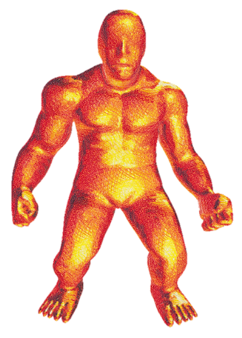
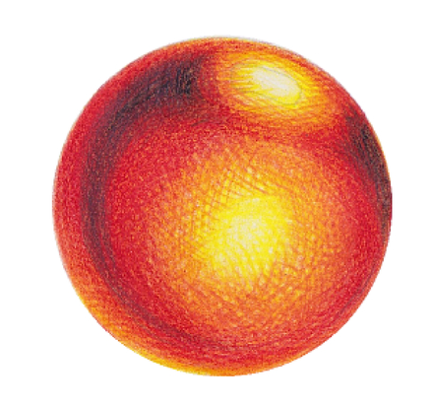
StyleBlit: Fast Example-Based Stylization with Local Guidance
Daniel Sýkora¹, Ondřej Jamriška¹, Ondřej Texler^{1,2},
Jakub Fišer², Michal Lukáč², Jingwan Lu², Eli Shechtman²,
500 fps

Slide 3
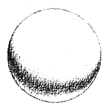
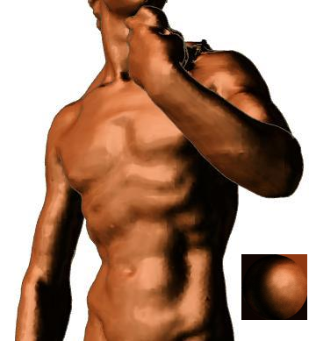
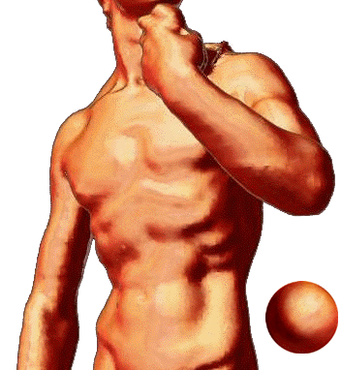
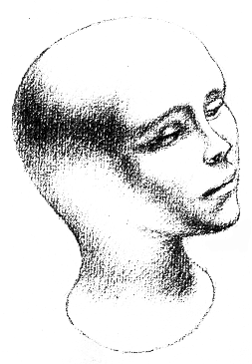
The Lit Sphere [Sloan et al. 2001]
a.k.a. MatCap (used in ZBrush, Maya, SoftImage, …)

Slide 4
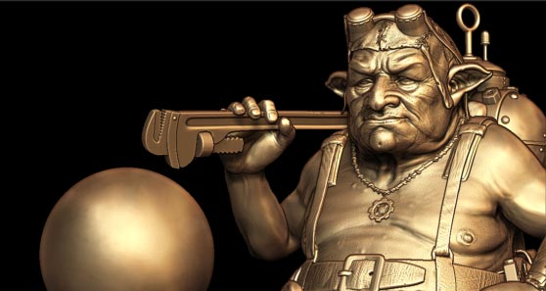
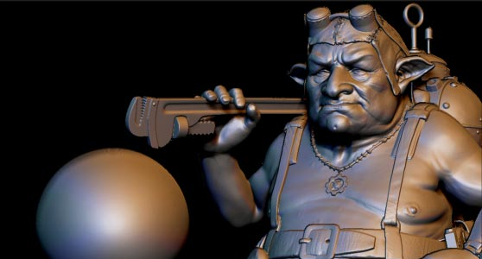
Low-Frequency MatCap

Slide 5
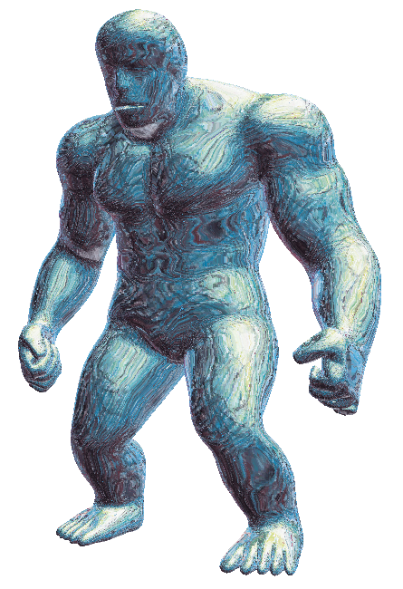
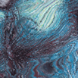
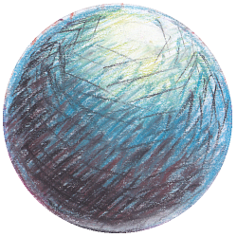

MatCap with High Frequencies
Artifacts!

Slide 6
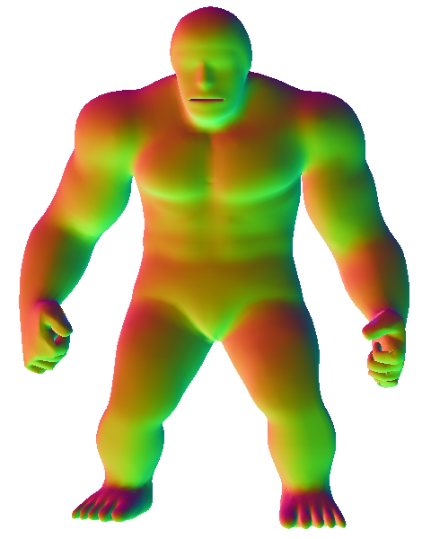
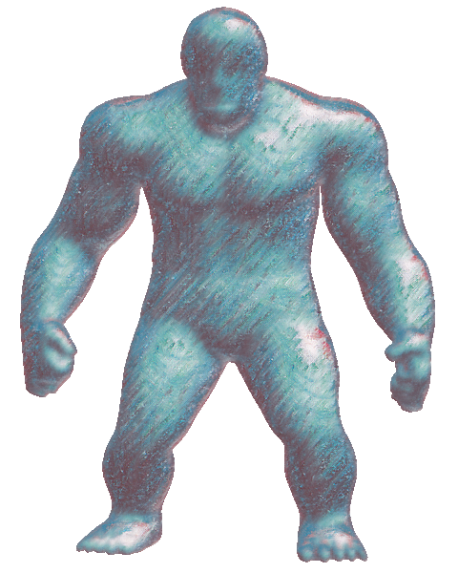
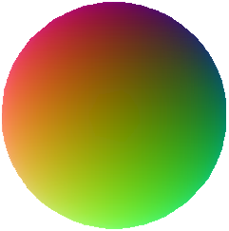
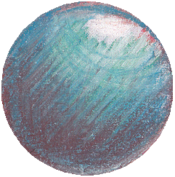
Guided Texture Synthesis
Target Guide
Result
Source
Guide
Style
Exemplar
Slow!
:
::
:
Image Analogies concept [Hertzmann 2001]
Synthesis algorithm: StyLit [Fišer et al. 2016]

Slide 7
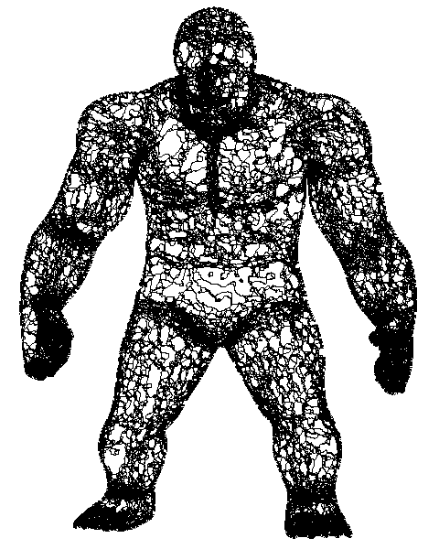
Inspiration
||Guide||
||Texture Coherency||
Optimization
3rd iteration

Slide 8

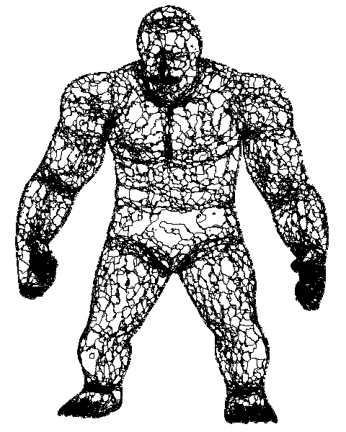
Inspiration
||Guide||
||Texture Coherency||
Optimization
32nd iteration

Slide 9
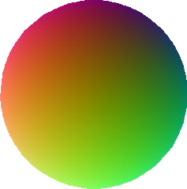
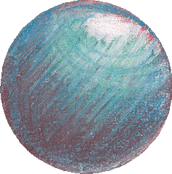
Algorithm

Slide 10
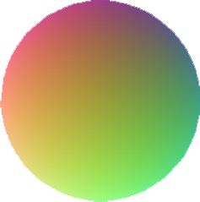
Algorithm

Slide 11
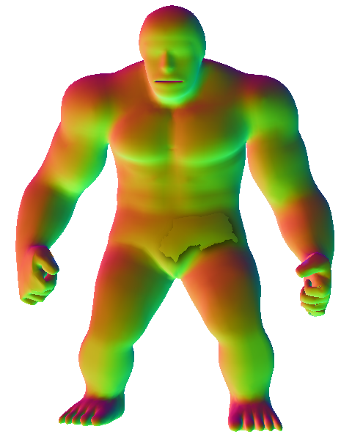
Algorithm

Slide 12
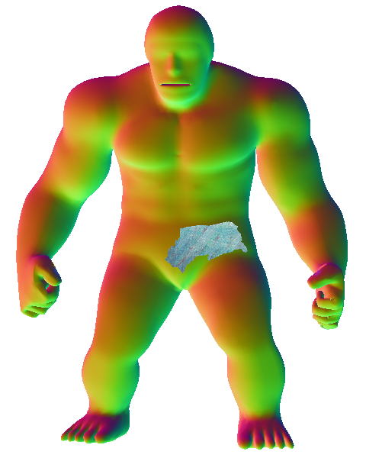
Algorithm

Slide 13
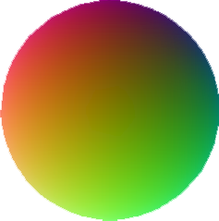
Algorithm

Slide 14
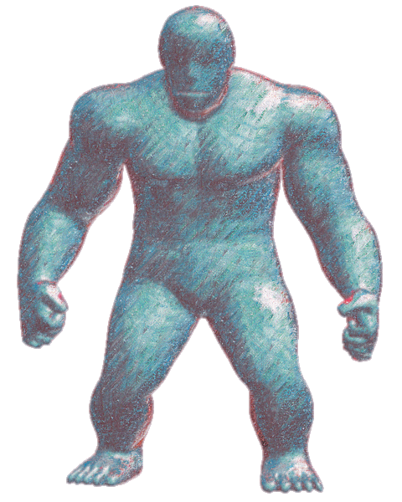
Algorithm

Slide 15
Algorithm - Fully Parallel
Coarse sampling
s
t
‖ t-s ‖ > threshold

Slide 16
Algorithm - Fully Parallel
Dense sampling
t
s
‖ t-s ‖ > threshold

Slide 17
Algorithm - Fully Parallel
Even-denser sampling
Independently
t
s
‖ t-s ‖ > threshold

Slide 18
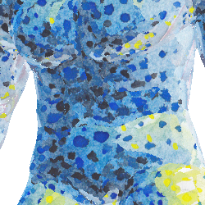
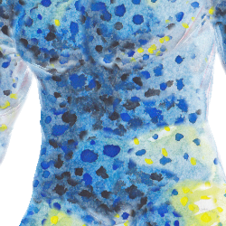
Boundary Blend - Voting
Raw Boundary
Blended Boundary

Slide 19
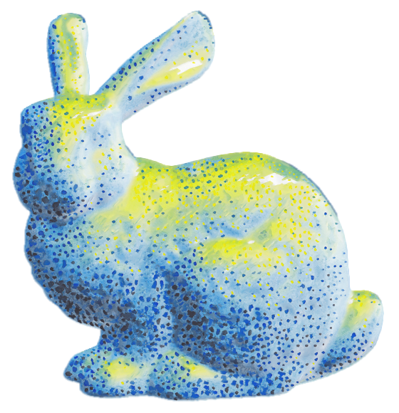
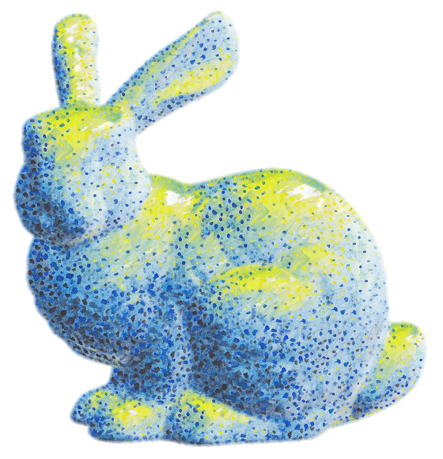
Comparison with StyLit
StyLit [Fišer et al. 2016]
56 sec (CPU)
Our approach
0.05 sec (CPU)

Slide 20
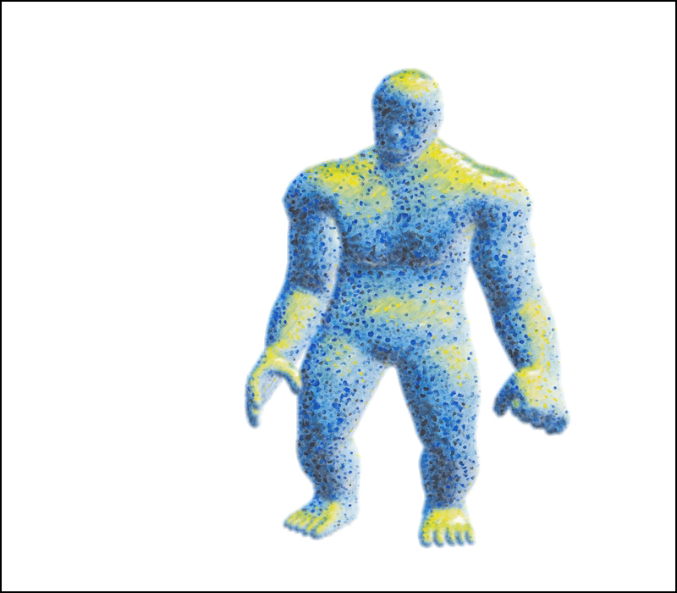
Results – Hand-drawn
Our approach on single core CPU (15 fps)

Slide 21
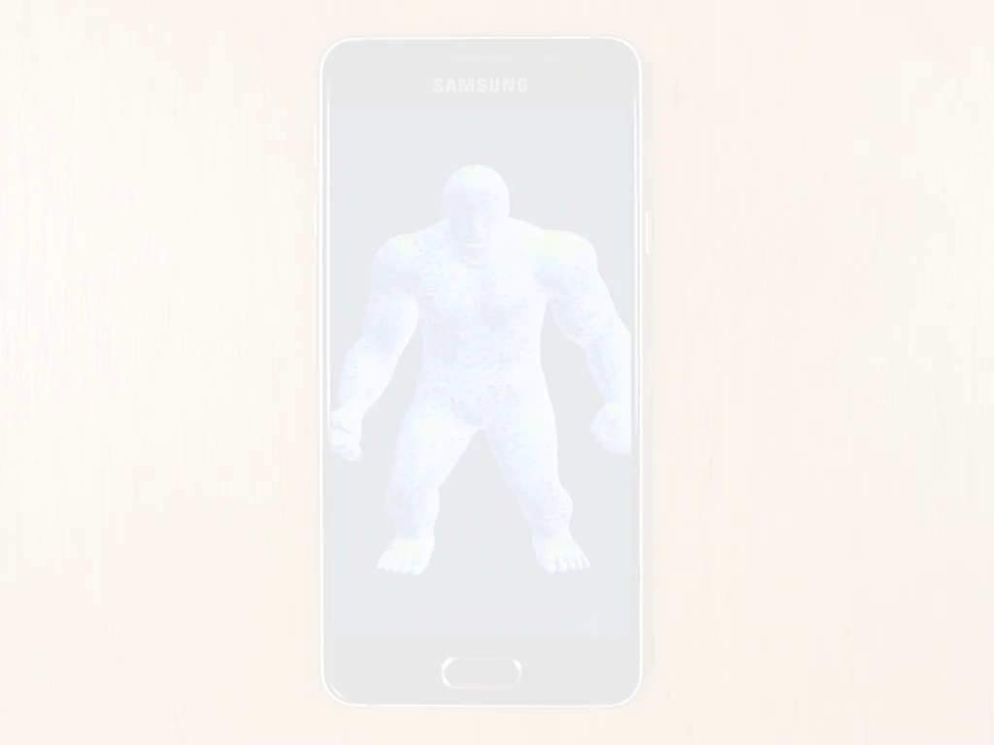
Results – Hand-drawn
Our approach on midrange mobile GPU (15 fps)

Slide 22
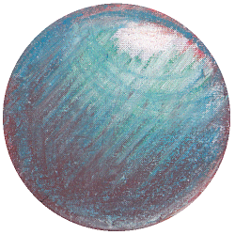
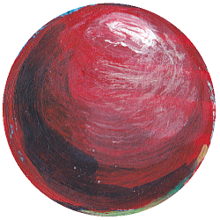
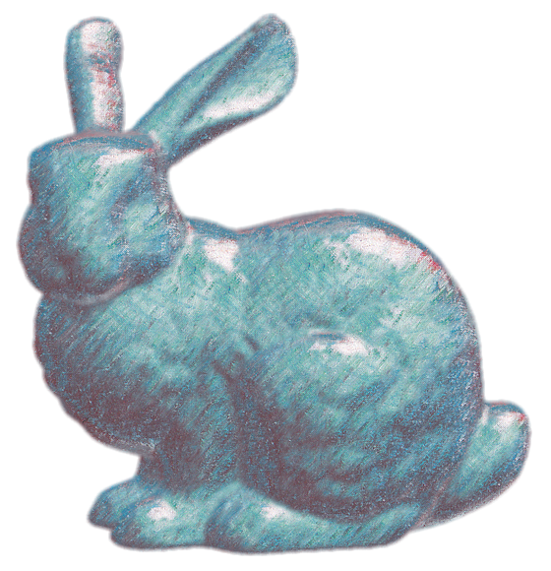
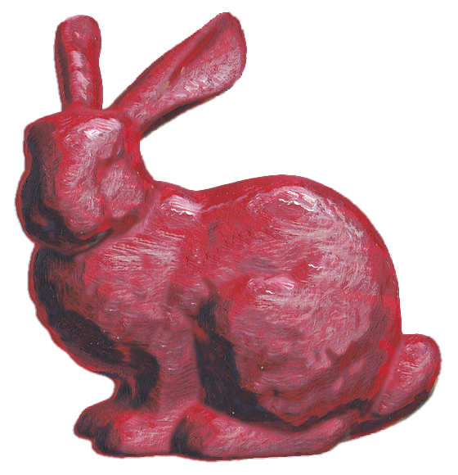
Results – Hand-drawn

Slide 23
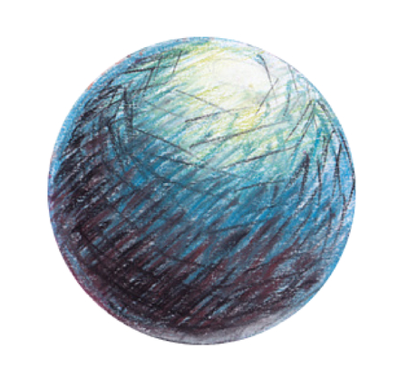
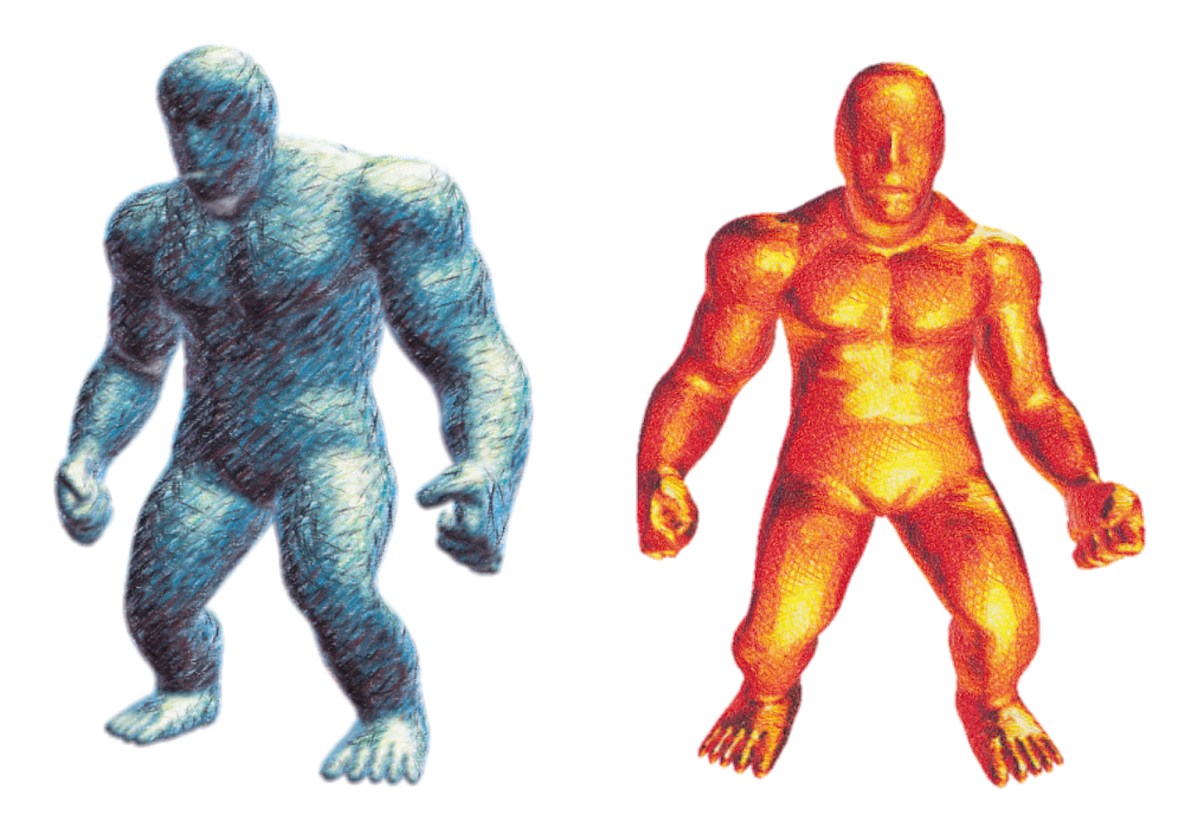
Results – Hand-drawn

Slide 24
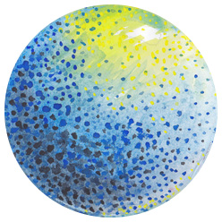
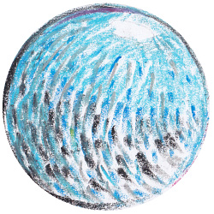
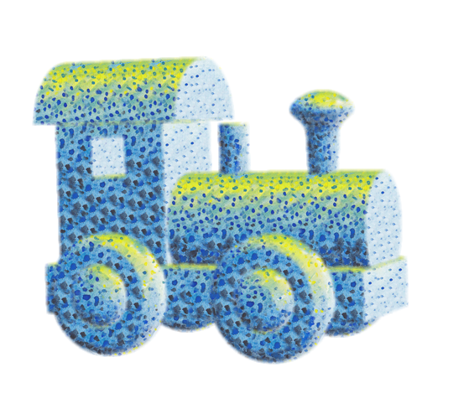
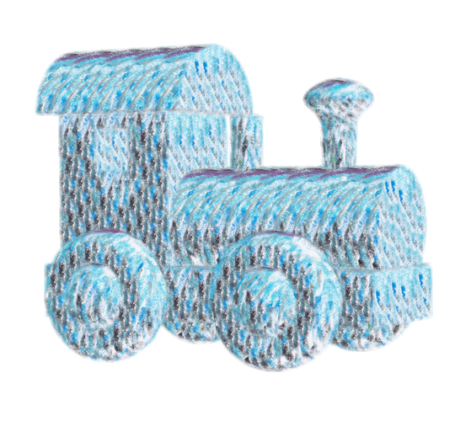
Results – Hand-drawn

Slide 25
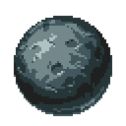
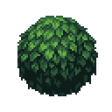
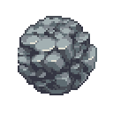
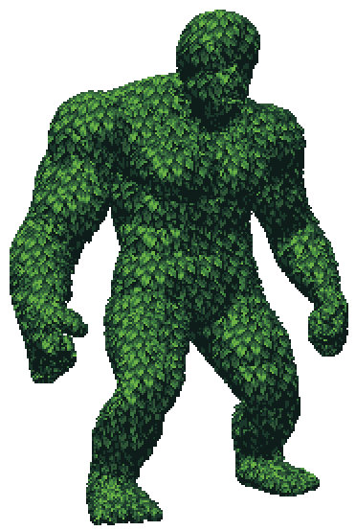
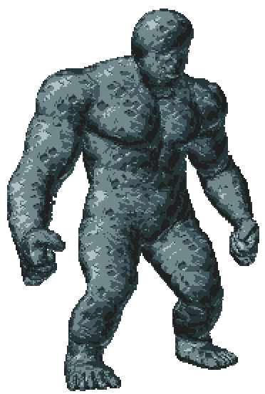
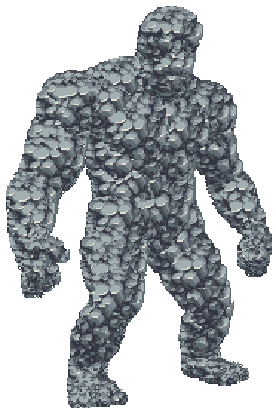
Results – Pixel art

Slide 26
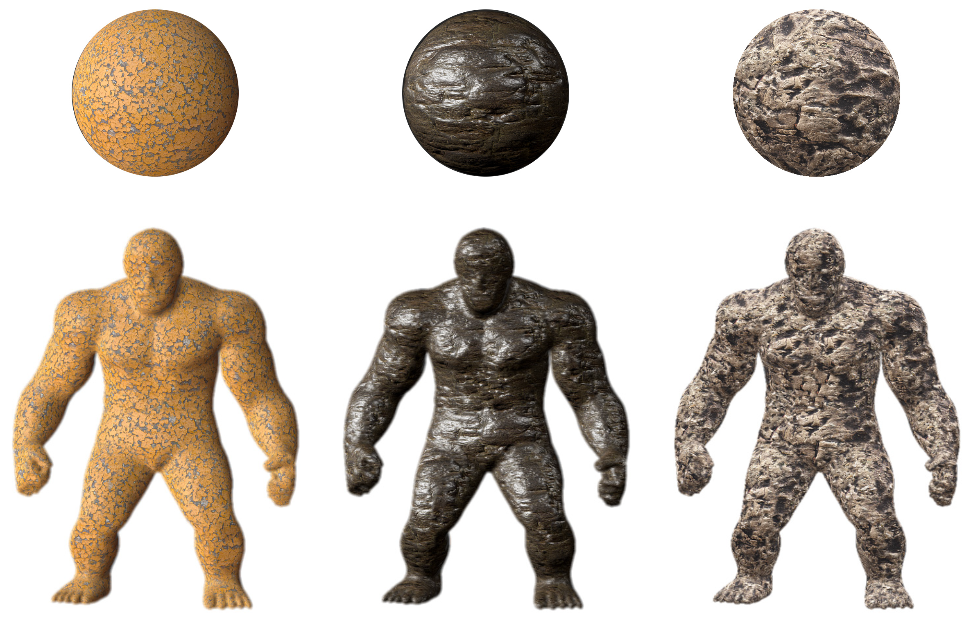
Results – Photo-realistic

Slide 27
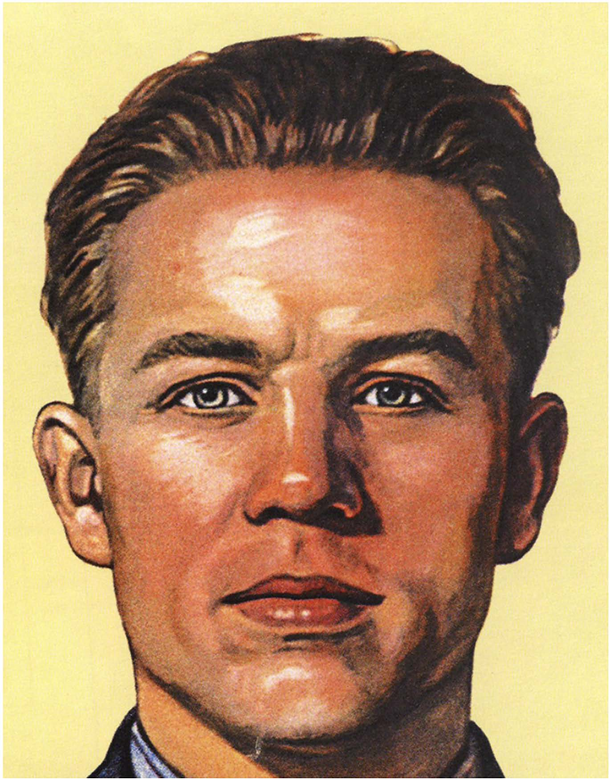
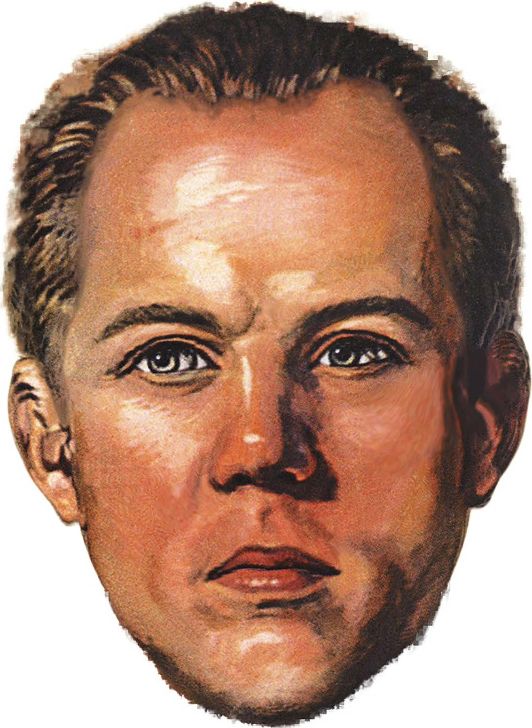
Face Stylization

Slide 28
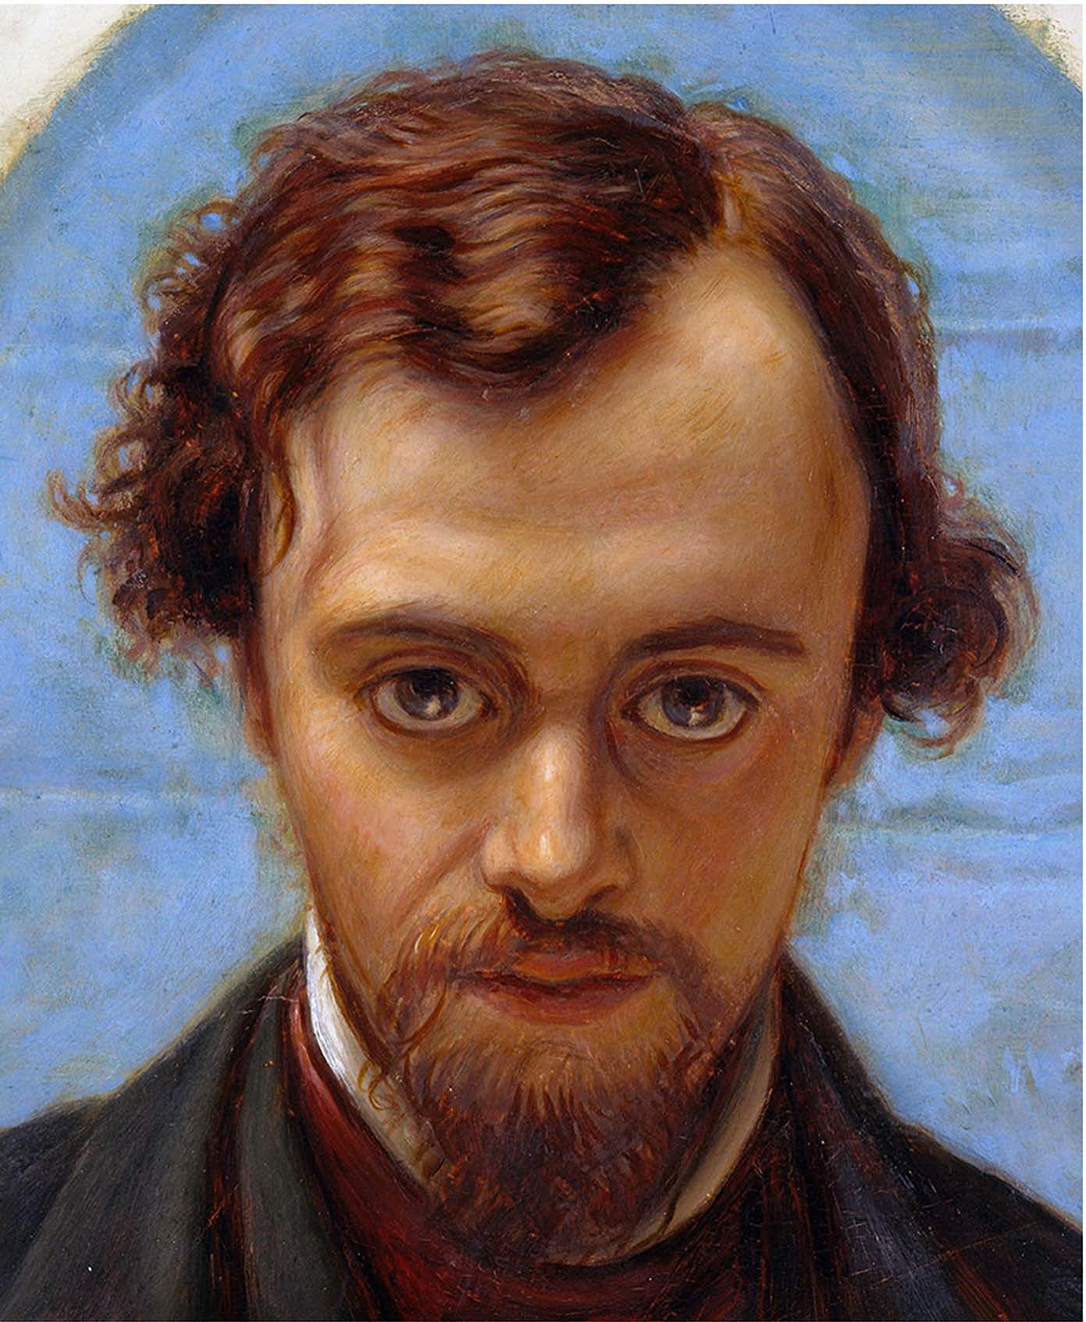

Face Stylization

Slide 29



Comparison with MatCap
The Lit Sphere
Ours
[Sloan at al. 2001]

Slide 30



Comparison with MatCap
The Lit Sphere
Ours
[Sloan at al. 2001]

Slide 31


Unity Asset

Slide 32

Unity Asset

